Slide 1
FDA FAERS Drug Safety Prediction Model
By: Carisa, Tarif & Josh
Notes:
Carisa

Slide 2
TABLE OF CONTENTS
01
02
03
04
05
Data Loading & Setup
Data Exploration
Data Cleaning & Processing
Models & Metrics
Results & Analysis
Notes:
Carisa

Slide 3
01
DATA: Loading & Setup
Notes:
Carisa

Slide 4
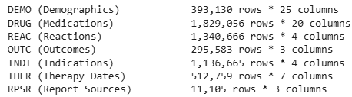
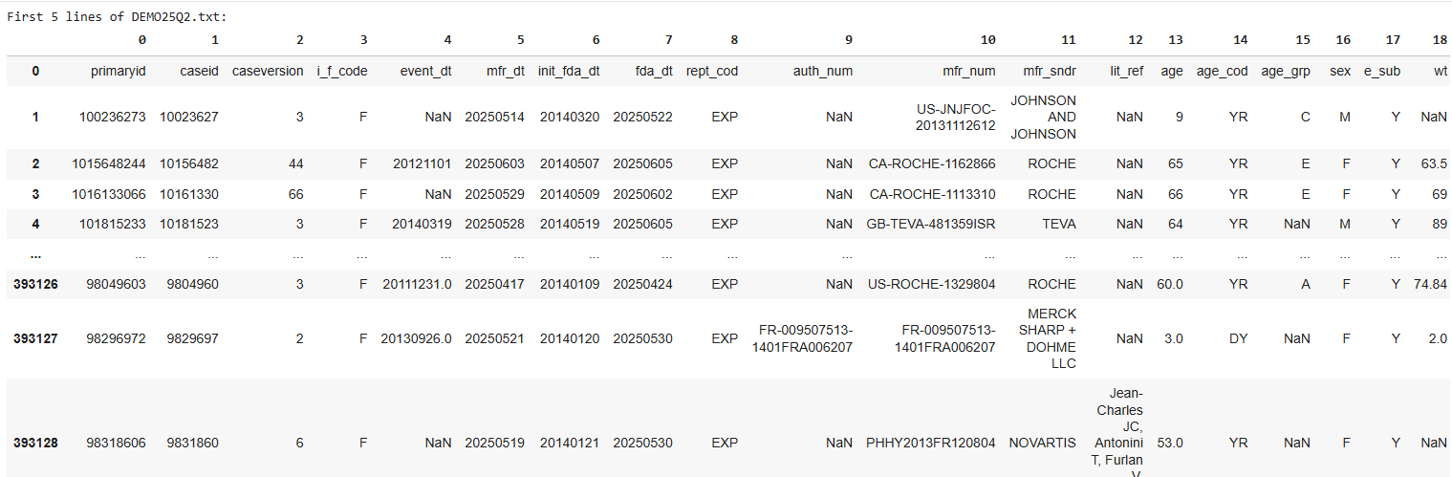
Data Loading and Setup
Loaded 7 tables from FAERS
Representing 393,130 ADE Reports
Higher Row counts = Patients take multiple medications and had adverse reactions per report
Notes:
Carisa

Slide 5
02
DATA: Exploration
Notes:
Carisa

Slide 6
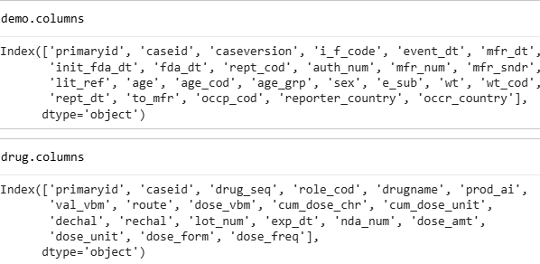
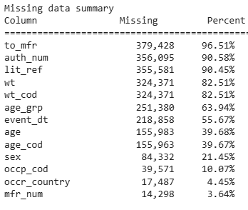


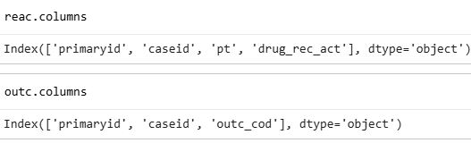
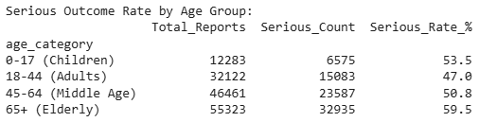
Data Exploration per Table
Columns
Missing Data
Target Variable
Table Structures and Names
Handling missing data
Outcomes = Serious / Non-Serious
Notes:
Carisa
44.6% serious outcomes
55.4% non-serious

Slide 7
03
DATA: Cleaning & Preprocessing
Notes:
Tarif

Slide 8
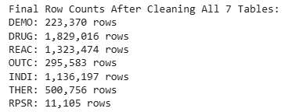
Cleaning and Preprocessing
Dropped without PRIMARYID
Dropped without AGE or SEX
Records without a PRIMARYID cannot be linked to the case report
Need to identity demographic of individual in event
Remove Duplicates
Removed rows that are IDENTICAL across *all* columns - Need to keep multiple unique report rows with the same PRIMARYID.
Notes:
Tarif
44.6% serious outcomes
55.4% non-serious

Slide 9
04
Models & Metics
Notes:
Tarif

Slide 10
Models and Metrics
LR
DT
KNN
Logistic Regression
Decision
Trees
K - Nearest
Neighbor
Probabilistic classification model using demographic and country features to predict serious outcomes
Accuracy, Balanced Accuracy, ROC AUC, Precision, Recall & F1
Same Metrics + Classification Report of Serious & Non Serious Events
Notes:
Tarif

Slide 11
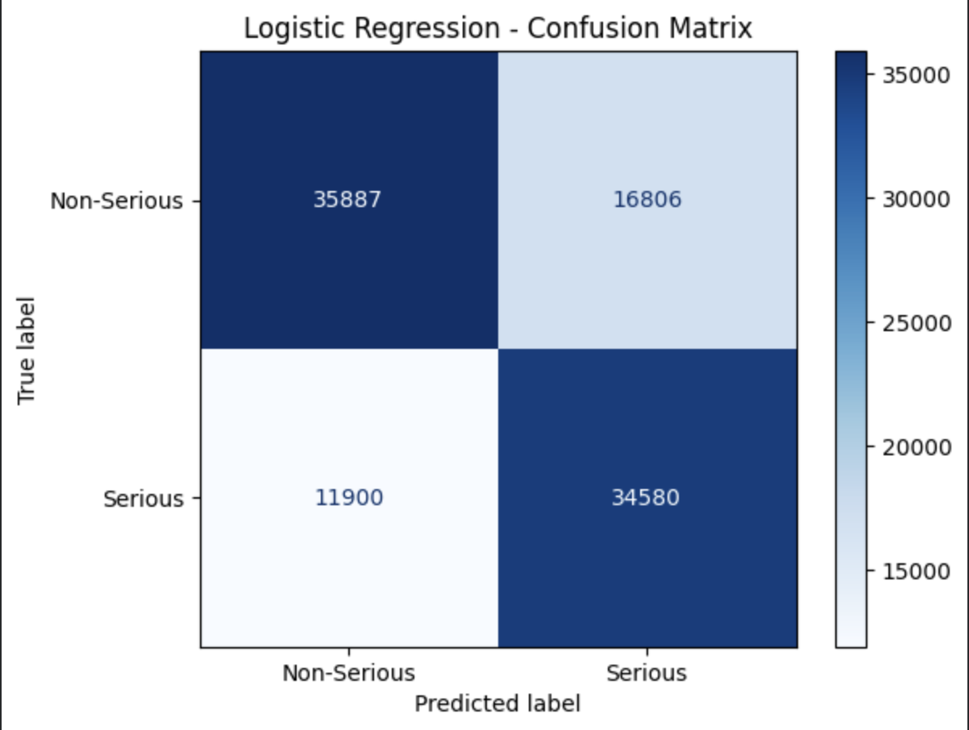
Logistic Regression
Accuracy = 0.7105
Balanced Accuracy = 0.7125
ROC AUC = 0.7886
Class 0 = Non-Serious Events
Precision: 75%
Recall: 68%
F1: 71%
Class 1 = Serious Events
Precision: 67%
Recall: 74%
F1: 71%
Notes:
Tarif

Slide 12
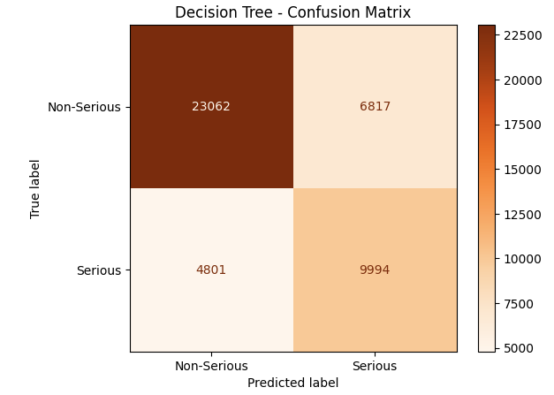
Decision Tree
Accuracy = 0.7399
Balanced Accuracy = 0.7237
ROC AUC = 0.8238
Class 0 = Non-Serious Events
Precision: 83%
Recall: 77%
F1: 80%
Class 1 = Serious Events
Precision: 75%
Recall: 74%
F1: 74%
Notes:
Josh

Slide 13
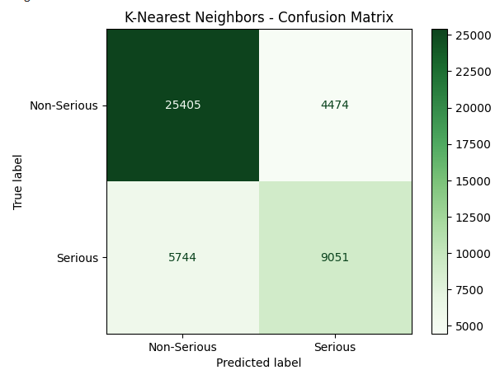
KNN
Accuracy = 0.7713
Balanced Accuracy = 0.7310
ROC AUC = 0.813
Class 0 = Non-Serious Events
Precision: 82%
Recall: 85%
F1: 83%
Class 1 = Serious Events
Precision: 67%
Recall: 61%
F1: 64%
Notes:
Josh

Slide 14
05
Results & Analysis
Notes:
Josh

Slide 15
Key Takeaways
Sex
Age
Males have 7.7 percentage point higher serious outcome rate than females
Males = 55.6% Serious
Females = 47.9% Serious
Young adults (18-44): 47.0% serious (lowest risk group)
Middle-age (45-64): 50.8% serious
Elderly (65+): 59.5% serious (highest risk group)
Children (0-17): 53.5% serious (surprisingly high)
Main Features
Hospitalization (HO)
Number of Drugs
Dose Amounts
Patient Demographics
Hospitalization is the Most Common Serious Outcome (~27%)
Death (DE) follows with about 9.5%
Our models are recommendations to predict whether an adverse drug event will result in a serious outcome
Notes:
Josh

Slide 16
06
Video Link
DSC_310_-_Zoom_Presentation.mp4

